Slide 1





Multi-objective simulation optimization of the adhesive bonding process of materials
Alejandro Morales-Hernández
University of Hasselt
alejandro.moraleshernandez@uhasselt.be

Slide 2

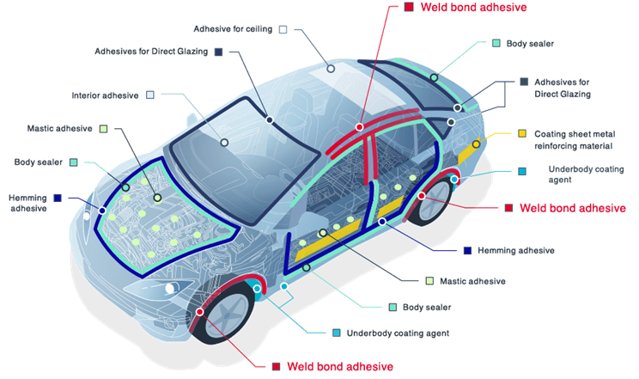

Motivation
Need for better fuel efficiency
Results in lighter bodies, new materials
Which tend to be more fragile, more difficult to join
The right bonding process will improve strength
Multi-objective optimization
Minimize cost VS. Maximize break strength
Real experimentation is expensive and yield noisy outputs
The same process configuration generates different break strength/type of failure
Different types of failure
Adhesive, cohesive, or substrate failure

Slide 3


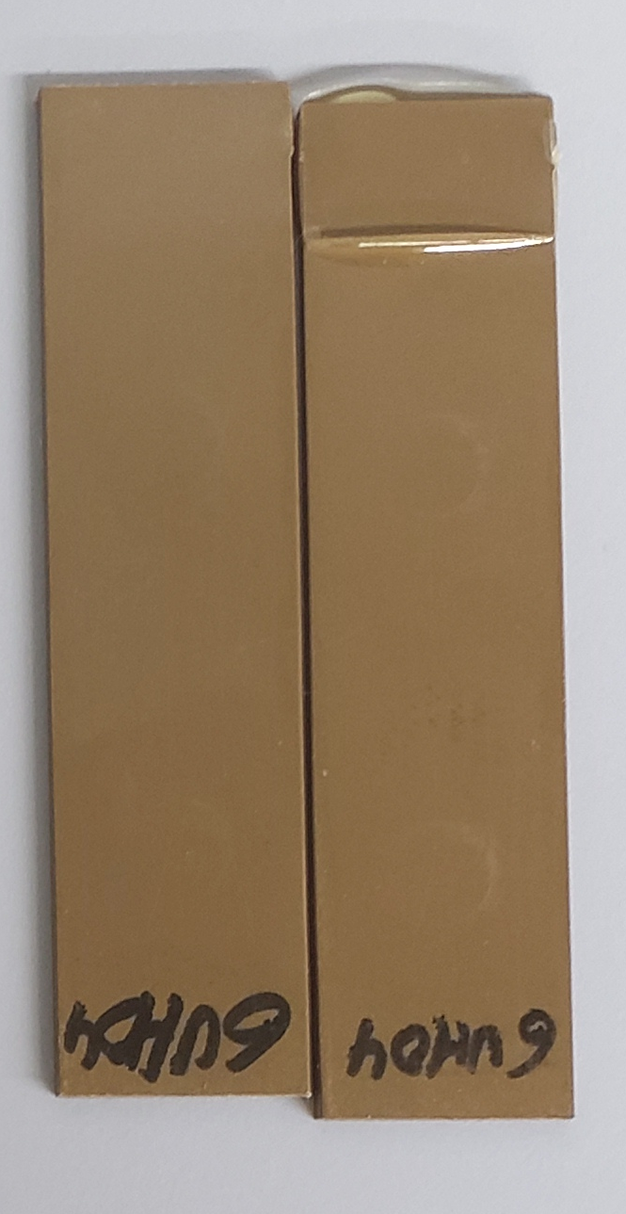
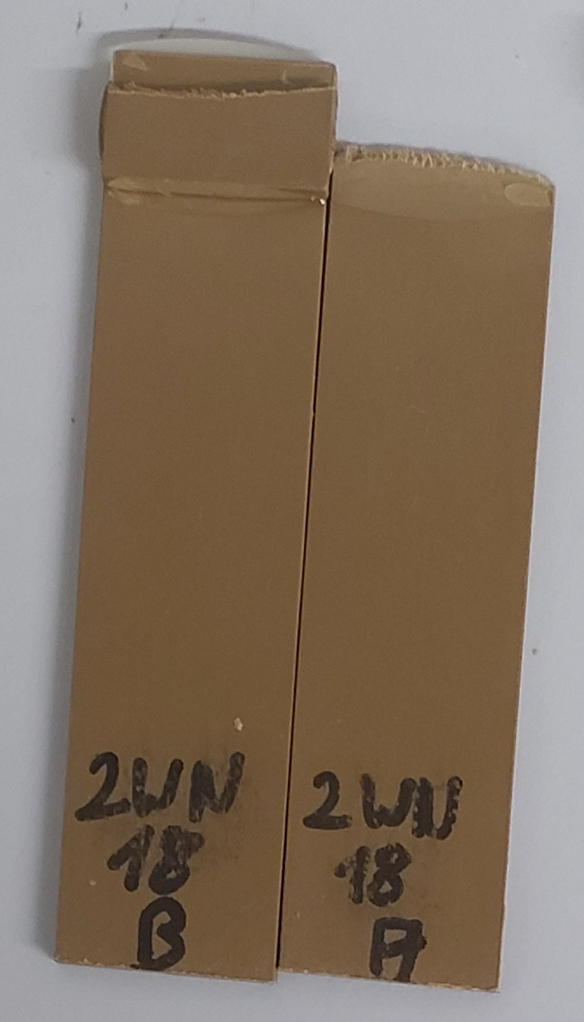
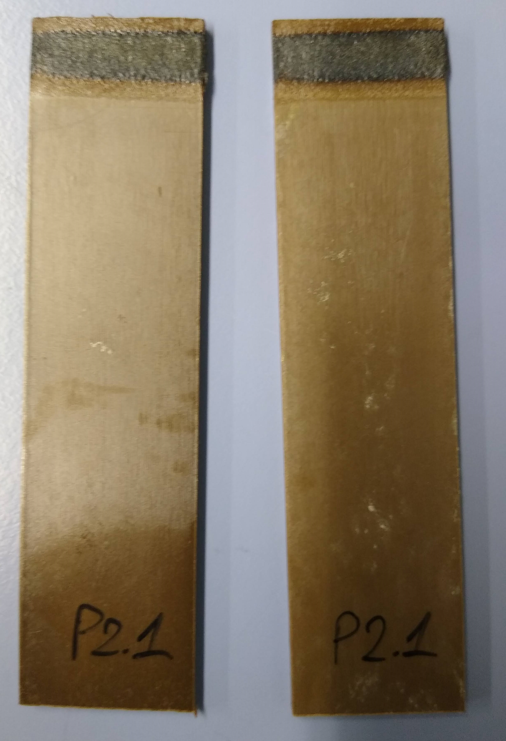
Objective
Efficiently find good process parameters with a minimal set of experiments, and considering the trade-off between product performance (strength) and production cost
Uncertain performance
Constrained optimization (feasibility)
Burned sample
Adhesive failure
Substrate failure

Slide 4
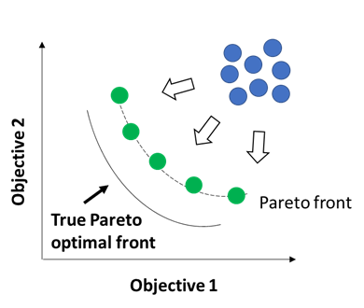
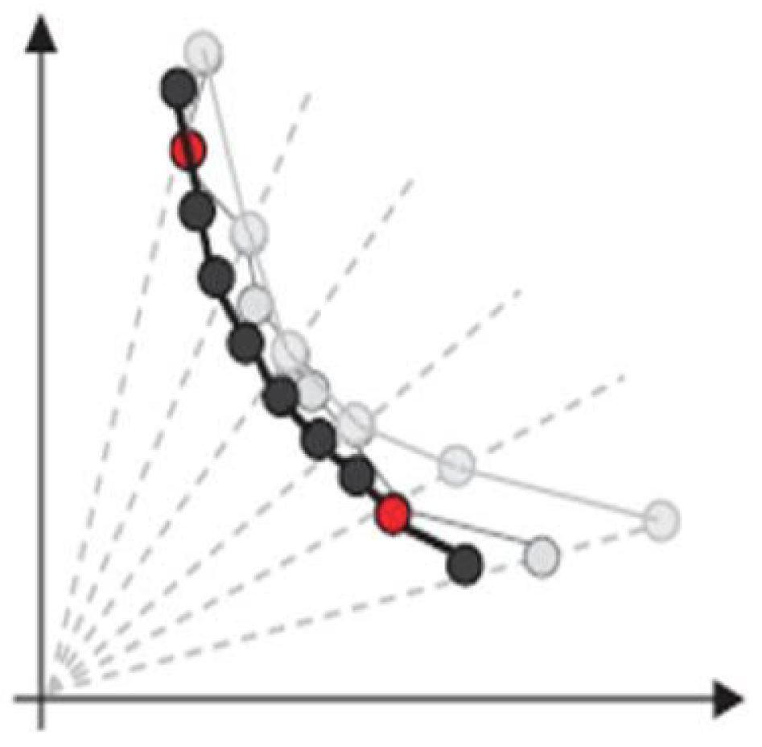

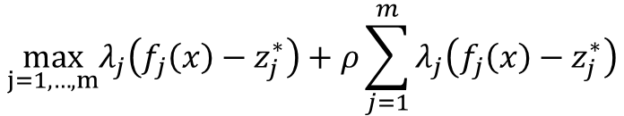
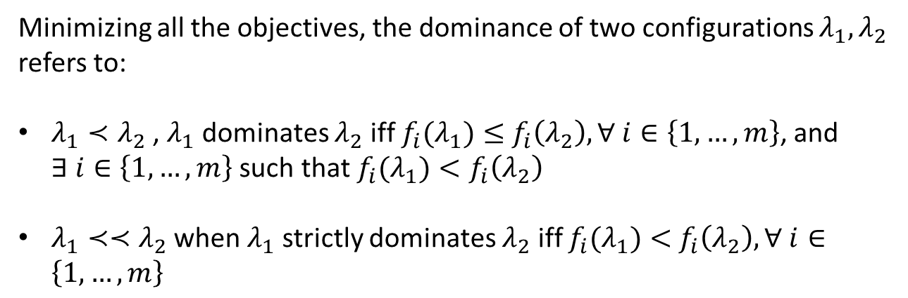
Multi-objective optimization
Minimizing all the objectives, the dominance of two configurations $λ_{1}, λ_{2}$ refers to:
$λ_{1}≺λ_{2}$ , $λ_{1}$ dominates $λ_{2}$ iff $f_{i}(λ_{1})≤$ $f_{i}\left(λ_{2}\right), ∀ i∈\left\{1,…,m\right\}$, and $∃ i∈\left\{1, …, m\right\}$ such that $f_{i}(λ_{1})<f_{i}\left(λ_{2}\right)$
$λ_{1}≺≺λ_{2}$ when $λ_{1}$ strictly dominates $λ_{2}$ iff $f_{i}(λ_{1})<$ $f_{i}\left(λ_{2}\right), ∀ i∈\left\{1,…,m\right\}$
dominated solutions
How to solve multi-objective problems?
Optimize all the objectives at the same time, considering its dominance relation
Transform the problem (scalarization functions)
Augmented Tchebycheff scalarization function
$$\max_{j=1,…,m}λ_{j}\left(f_{j}\left(x\right)−z_{j}^{∗}\right)+ρ\sum_{j=1}^{m}{λ_{j}\left(f_{j}\left(x\right)−z_{j}^{∗}\right)}$$
NSGA-II
Weight for objective j
Small positive value
Ideal value

Slide 5
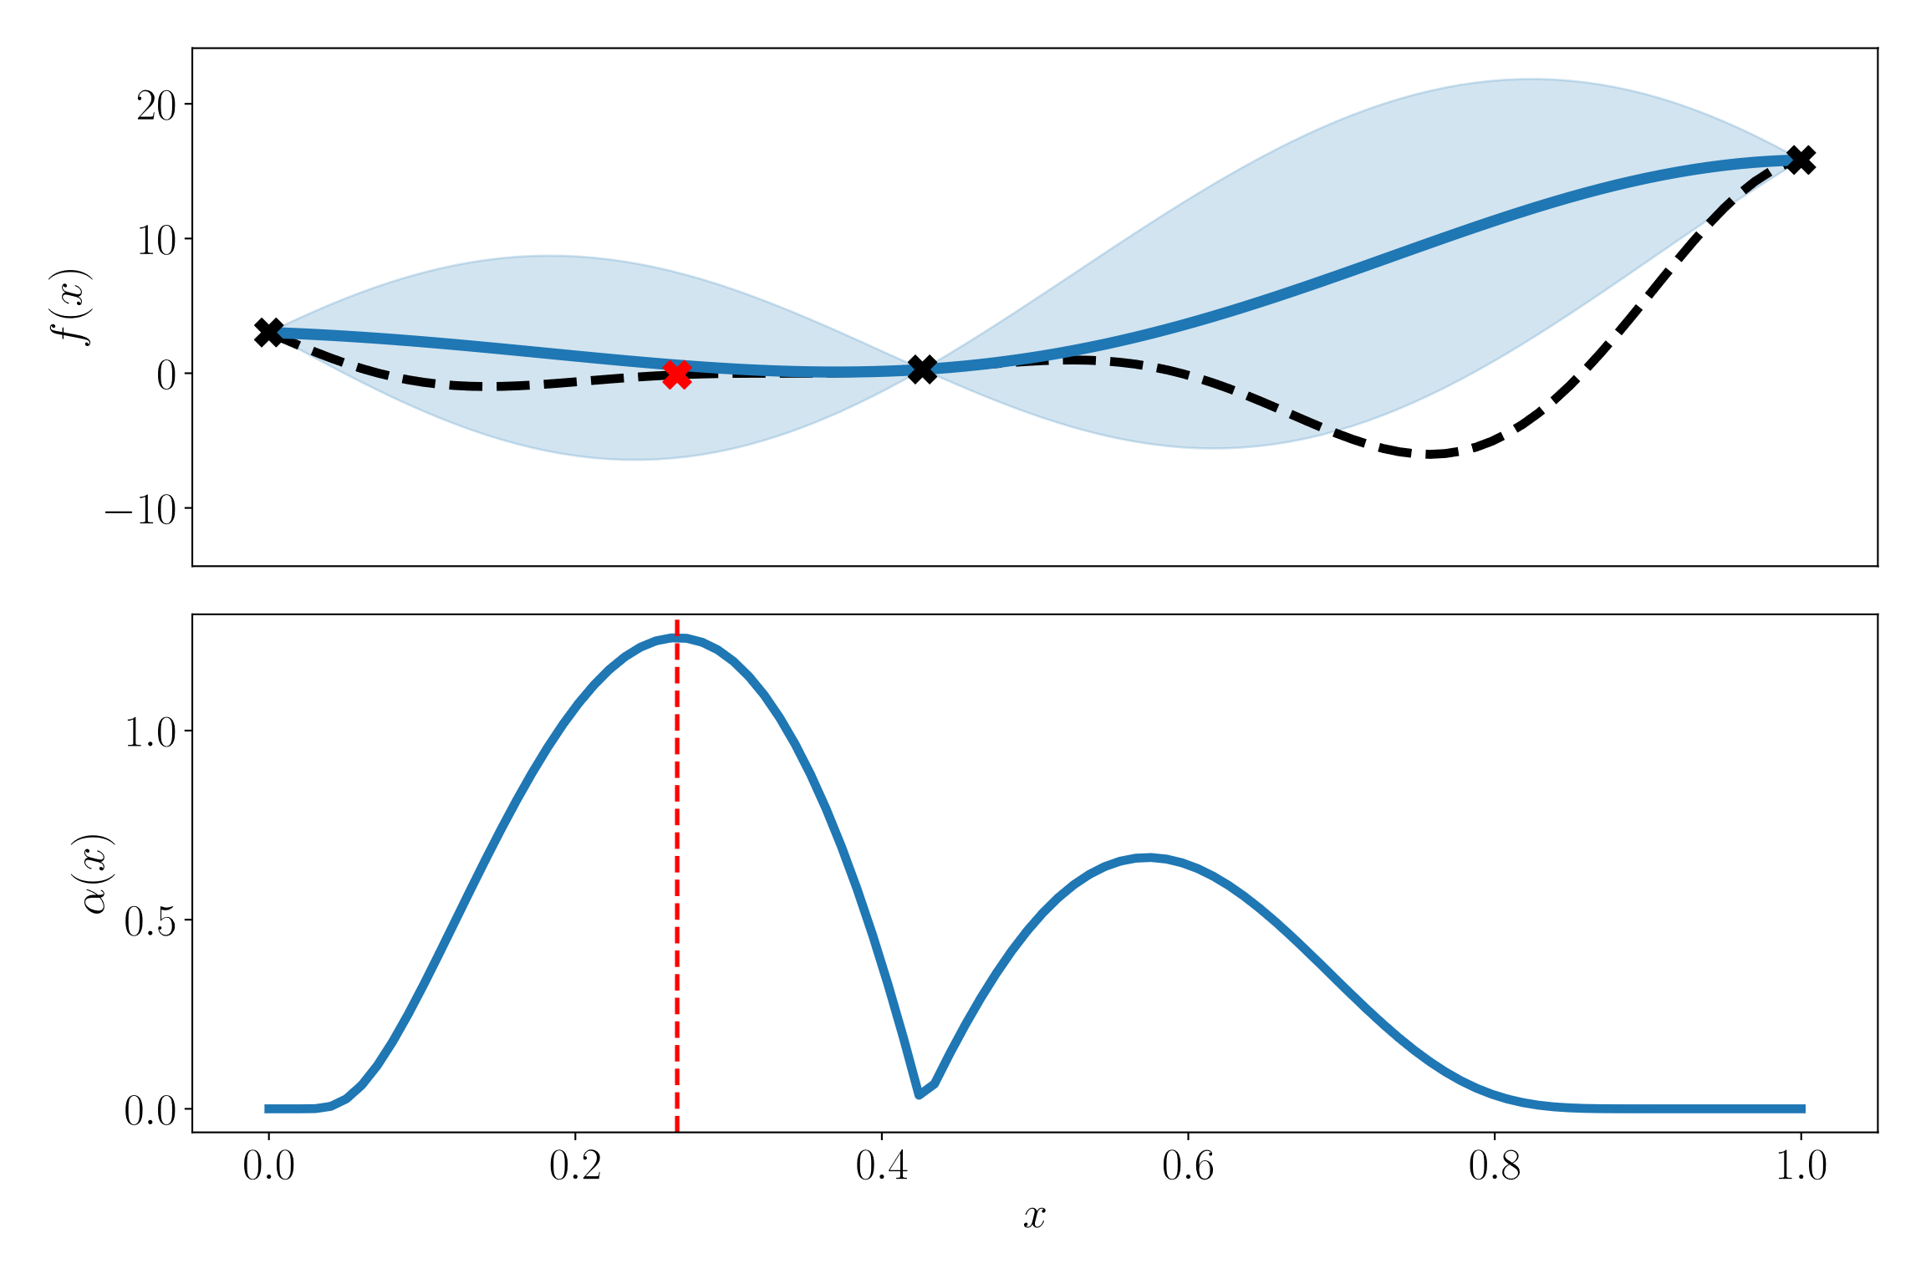
Metamodel-based optimization
Metamodel
Goal:
Assuming minimization
New point
Expensive function
Build metamodel
Optimal solution(s)
Initial design
Add new point
Calculate acquisition function

Slide 6
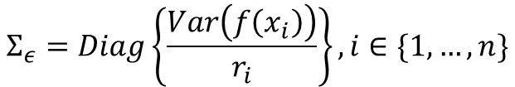
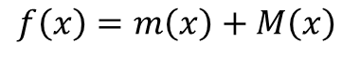
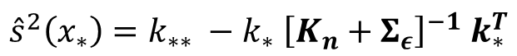
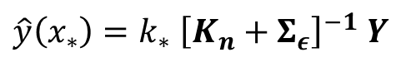
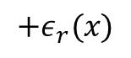
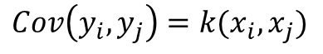
Gaussian Process with heteroscedastic noise
Mean of the process
Noise observed in replication r
Function representation:
$$f\left(x\right)=m\left(x\right)+M\left(x\right)$$
$$+ε_{r}(x)$$
unknown response function
Realization of a Gaussian random field with mean zero (covariance function)
$$Cov\left(y_{i},y_{j}\right)=k(x_{i},x_{j})$$
Predictor and uncertainty estimator:
Spatial correlation among the new point and the observed points
predictor
$$\hat{y}\left(x_{∗}\right)=k_{∗} {\left[K_{n}+Σ_{ε}\right]}^{−1} Y$$
Observed response of the n points
Covariance matrix of the n observed points
$$Σ_{ε}=Diag\left\{\frac{Var\left(f\left(x_{i}\right)\right)}{r_{i}}\right\}, i∈\{1, …, n\}$$
Noise estimation for the n points
Uncertainty estimator
$${\hat{s}}^{2}\left(x_{∗}\right)=k_{∗∗} −k_{∗} {\left[K_{n}+Σ_{ε}\right]}^{−1} k_{∗}^{T}$$
Covariance function applied to the new point and itself

Slide 7
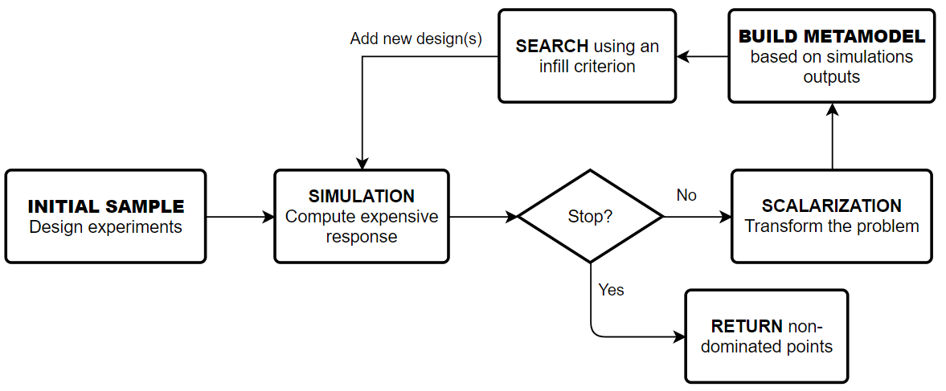
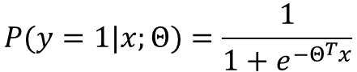
Approach
Smartly choose next design point(s) for expensive observation
Infill criterion: Modified Expected Improvement * Probability feasibility
Particle Swarm Optimization
Logistic classifier
GP model for noisy outputs
Outcome prediction at non-observed points
Uncertainty estimate of outcomes
Train a classifier
$$P(y=1|x;Θ)=\frac{1}{1+e^{−Θ^{T}x}}$$
Augmented Tchebycheff scalarization
Dynamically assignment of weights
Smartly choose initial design
Replicate to account for noise
Latin hypercube sampling
Any experiment with noisy outcomes
Simulator provided by JMLab

Slide 8
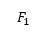
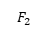
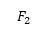
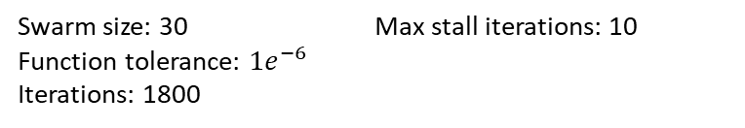
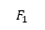
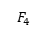
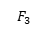
Experiment design
Process parameters | Min | Max
Pre-processing | 0 | 1
Plasma power | 300 | 500
Plasma speed | 5 | 250
Distance | 0.2 | 2
Number of passes | 1 | 50
Real time | 1 | 120
Acquisition function optimization: PSO
Swarm size: 30
Function tolerance: ${1e}^{−6}$
Iterations: 1800
Max stall iterations: 10
MO-GP setting:
Covariance function: Gaussian
Initial design size: 30 (LHS)
Iterations: 180
NSGA-II with feasibility constraint
Non-dominated sorting of feasible and non feasible configurations
$$F_{1}$$
Crowding distance sorting of feasible and non feasible configurations
$$F_{2}$$
P
P
$$F_{2}$$
Expensive evaluations for NSGA-II and GP (budget): 210
Comparison metric: Hypervolume indicator
$$F_{1}$$
$$F_{2}$$
NSGA-II setting:
Population size: 10
Iterations: 20
P. crossover: 0.9
P. mutation: 0.5
Q
$$F_{3}$$
Rejected
R
$$F_{4}$$

Slide 9
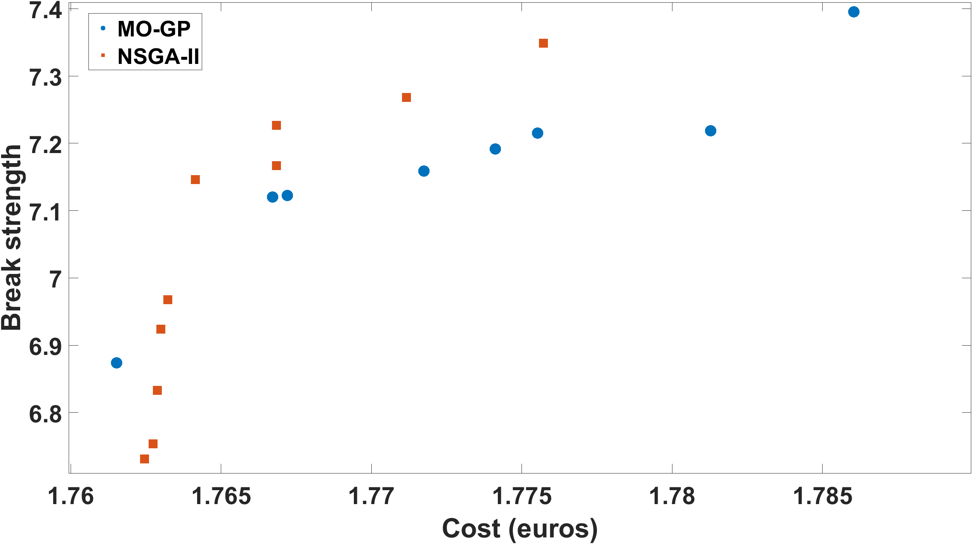
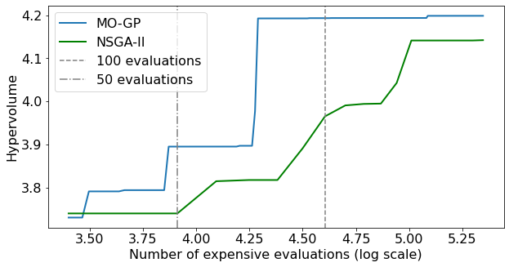
Results
MO-GP converges to a hypervolume that is superior to the one obtained with NSGA-II, requiring only a fraction of the allowed function evaluations

Slide 10
Conclusions and future work
Machine Learning techniques allows to obtain high-quality solutions within a smaller number of experiments, compared with a popular and well-known algorithm such as NSGA-II.
The use of the infill criterion allows the algorithm to efficiently search for the Pareto-optimal process settings, exploiting the information that has been learned from the already observed process settings (through the GPR and LRC models)
Future research will focus on the development of an interactive software tool, allowing lab experts to validate the results generated by the algorithm in a real-life test environment, and to apply this type of algorithm also to other process optimization problems.

Slide 11
Multi-objective simulation optimization of the adhesive bonding process of materials
Alejandro Morales-Hernández
University of Hasselt
alejandro.moraleshernandez@uhasselt.be

